Slide 1

Dot Net 1.1XML Web Services
- Govardhan Reddy D N
Royal Sapphire Edu
Prog XML Web Services
Appendix
MS Press
Online

Slide 2
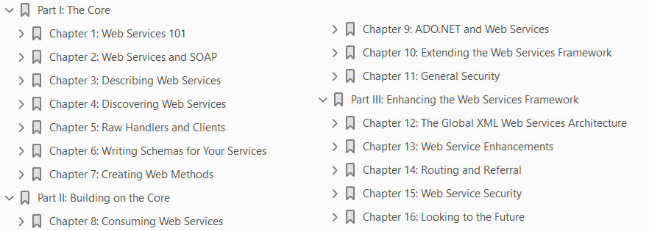
Prog XML Web Services
Book Name: Programming Microsoft .NET XML Web Services 2004
Book Source:

Slide 3
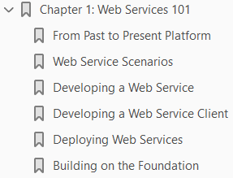
Web Services 101
1

Slide 4
Intro
The Microsoft .NET Framework has provoked divergent opinions since its beta release at the Microsoft Professional Developers Conference (PDC) in July 2000.
Microsoft developers consider it a breath of fresh air and a great foundation on which to program.
To open source and Java developers, it’s simply Microsoft’s attempt to catch up with Java, although many in this group admit a grudging respect for its standards-based core.
Managers, who see it as just another toy for developers to play with, are wondering, “Why can’t we stick to the old way? There’s nothing tangible that distinguishes a .NET application from a COM-based one anyway, is there?”
As a .NET developer reading this book, you already know the answer to the managers’ questions.
The .NET Framework improves on Microsoft’s COM architecture for applications and compares favorably with every other development platform in use.
We could spend the next 10 pages listing its benefits and disadvantages, but rather than repeat what’s been said several hundred times by others, we’ll spend the next 15 chapters looking at just one big plus—Web services.
Web services have been sufficiently misunderstood that their uptake has been slower than might have been expected.

Slide 5
Intro |
However, they represent the next step in a lot of efforts
distributed computing
interoperability,
Internet-based applications,
access to legacy data…the list goes on
But, like the main character in Rocky at the beginning of the movie, the technology has yet to prove itself the world-beater that it is.
For the past few years, rather than creating the killer Web service application, the developers and standards bodies have focused their efforts on strengthening the underlying technologies on which Web services work.
As the plumbing nears completion and we wait for the eBay of the Web services world to appear, now is the time to start learning about this maturing technology.
Our view is perhaps better explained by a look at the evolution of the Web services architecture, the technologies it has been designed to reinvigorate and the problems it has been created to solve, and the questions the architecture itself has asked.
You’ll see why Web services had to be invented and what role they play in today’s systems.

Slide 6
From Past to Present Platform
In the beginning, the universe was created. This has made a lot of people very angry and been widely regarded as a bad move. —Douglas Adams
Like all things (even the universe), the Internet and the World Wide Web were not created perfect.
When Tim Berners-Lee invented HTML and HTTP in 1990, he did it to make academic papers and other texts easily available to those who wanted to read them.
This humble aim is hardly recognizable in the powerful, glitzy, customized, interactive sites of today, as companies sell their wares and plumb the depths of their corporate data for thousands of clients at a time.
Still, the goal of data dissemination holds true.
Needless to say, HTML 1.0 wasn’t designed with online markets in mind. Only in its sixth incarnation—XHTML 2.0— which came into being while this book was being written (http://www.w3c.org/TR/xhtml2)—does it cater to the current and future needs of the Web development community.
The same is true of HTTP 1.0. HTTP 1.1 plus authentication digest and cookies, along with HTTPS, provide the backbone of today’s online community.
A great deal has happened to HTML since its inception. Central to that development has been a change of thinking. In 1993, a Web site was thought of as a collection of associated pages, much like a book or a thesis.
Today, a Web site is thought of as a Web- based application.

Slide 7
Web Applications
Faster than the adoption of the Web by users was the adoption of server-side programming for the Web by developers.
Client-side scripting let us give users the impression of some personalized interaction when they visited a site, when in truth there was little, if any.
The Common Gateway Interface (CGI) gave developers control over what users saw, but it was difficult to learn and left everything beyond the basic input/output connection between client and server to the programmer.
It was only in 1996 when Philip Carmichael designed and implemented version 1.0 of Active Server Pages (ASP) that we had something to sink our teeth into.
Then version 2.0 arrived the following year as part of the Windows NT Option Pack, and we realized just how much we could actually do.
What ASP and its contemporaries—JavaServer Pages (JSP), PHP, and ColdFusion—offered developers was the ability to glue all the resources they had for traditional server-based applications to a Web-based front end.
Web sites were no longer simple collections of single pages.
They had become individual applications whose appearance and content could be tailored to the user.

Slide 8
Web Applications |
Developers had a quick and reliable way of maintaining the state of a user’s session across the stateless HTTP protocol and could dynamically generate content tailored to that user by asking for and reacting to the user’s input.
They could make use of information stored in databases and create compiled business components on the server side, leading to faster reactions to a user’s clicks and requests.
They could design these components just like any other three-tier application. (See Figure 1-1.)
That we could approach Web development much as we did a windowed application was a revelation.
Very quickly, huge sites (and not just ecommerce ones) appeared on the Web, enabled by server-side technology.
They kick-started the dot-com boom.

Slide 9
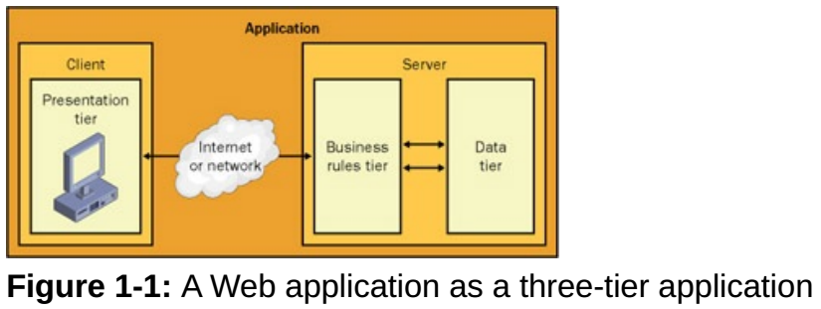
Figure 1-1

Slide 10
XML
Soon after he published HTML 1.0, Tim Berners-Lee realized that the Web was becoming a digital Wild West with different lawmen (browsers, companies) making their own laws and developers struggling to provide the same sites to users under different jurisdictions.
In 1994, he and Michael Dertouzos founded the World Wide Web Consortium (W3C) with the purpose of creating open standards for the Web that everyone should adhere to instead of building and using their own technologies.
HTML was one of the first Web technologies they published as a standard (with HTML 3.2 coming in 1997), and a little over a year later, in February 1998, they released version 1.0 of the XML specification.
XML has been a cornerstone in the development of the programmable Internet, thanks to what it does and what it doesn’t do.
Instead of being designed for a specific purpose, like HTML, which is designed to identify and mark up the various elements in a Web page, XML is designed as a metalanguage.
That is, it provides the foundation for marking up anything we want—record collections, books, mathematical equations, chemical formulas, the contents of our databases, and so on—in plain text.
By using XML to mark up data, we can make that data available in a platform-neutral format that can be shared online regardless of the operating system, database, and firewalls the host platform uses.

Slide 11
XML |
All that’s required of the receiving system is the ability to parse the XML data and act on it.
The parsing implies a slight performance hit, of course, but the gains of universally acceptable data far outweigh the hit.
A few other problems needed getting around, of course.
The first was simply that two XML grammars might define a tag with the same name. How would parsers translate the tag?
Namespaces were introduced to solve that problem, offering ways to define an unambiguous context within which to place tags.
Together, XML and namespaces form the basis of all XML standards.
Even text itself presented developers with a few obstacles. Base64 encoding offered one solution for sharing pictures and sounds, but what about the encoding of the text itself?
Every machine running Windows presented at least two encoding schemes— MS-DOS codepages and ANSI encoding—and many localized character sets.
The solution was to base XML on the then-current version of Unicode (2.0) and have XML documents declare what character set and language their text was written in.

Slide 12
XML ||
XML parsers are required to understand Unicode and its most important encodings, so data can be safely exchanged between platforms.
Now that Unicode 3.1 is stable, XML also needs to be updated, and sure enough, XML 1.1 is being prepared accordingly.

Slide 13
XML Schemas

Slide 14
Distributed Applications
Parallel to the development of Web-based applications, the industry also made inroads into the construction of distributed applications.
Distributed in this case meant applications splitting their workload privately and securely over more than one machine using their system’s own Remote Procedure Call (RPC) protocol to call methods and send information from machine to machine to machine as if they were all the same machine.
However, not for want of trying, the architectures and frameworks on which distributed applications were built—DCOM, CORBA, Java RMI— worked exclusively with themselves.
The machines were tightly coupled together, and each architecture had its own RPC protocol, message format, and message description language.
That is, an application written in CORBA would not cooperate with—or, indeed, understand—the same application written in DCOM or Java RMI on another machine, and vice versa.
More important, your machines’ setups had to be almost identical to get a distributed application to work at all.
Not only did all three architectures exist on several operating systems, but you also faced an uphill struggle to reconcile different data types, security systems, and debugging environments.
For Java users, this was slightly less of a problem, but in general, such applications weren’t as distributable as you might have wished.

Slide 15
Building the Platform
Rather than trying to build a replacement for distributed application frameworks and protocols, those working to evolve the Web application beyond n-tier applications realized they could take the idea of a distributed application’s binary calls across machine boundaries and turn them into platform-neutral calls—matching a Web application’s indifference to platform and operating system.
By 1998, the term Web services had been coined by either Andrew Layman or John Montgomery of Microsoft (they both think the other guy did it) to characterize this Web-based framework, and the model for the platform that enabled this ability was given some serious thought.
Like any other distributed application framework, it needed the following:
A platform-independent format language for structured data exchange
A way of describing the structure of the data being exchanged
A standard method of packaging the data for transmission over the Internet
A way for Web services to describe their public interface to clients
A framework for programmatically locating Web services via their capabilities or description
The model was sound, but of course large pieces of it didn’t exist yet.
Developers already had XML and XML Schemas for the transmission and description of data, and they had HTTP as a transport protocol.

Slide 16
Building the Platform |
All of these were common to all systems, but how could they transform RPC calls over a proprietary protocol into something any system could receive and understand?

Slide 17
SOAP
The answer once again was to use XML, and in 1999 version 0.1 of the Simple Object Access Protocol (SOAP) was released by Don Box, Tim Ewald, and a few others.
Now in version 1.2, SOAP describes a message framework for a function call and answer from one machine to another in the manner of RPC but formatted as an XML text stream rather than as a binary call.
A SOAP message, be it a request or a response, is written in plain XML text and adheres to the SOAP standard, so any system can understand what it says and act accordingly.
SOAP 1.2 even caters to the serialization of complex objects into text-based XSD-typed collections of their properties.
Thus you can make calls in SOAP to any remote method regardless of the complexity of the method’s parameters or return type.
SOAP has developed rapidly since its inception, but it has stuck to one of its goals—to keep things simple.
You’ll see how simple a little later on.

Slide 18
WSDL and UDDI
With a way for client and service to converse and exchange data, the next question was how to describe the interface between the two and the required resources: the type and structure of the calls, required parameters, return values, protocol bindings, and so on.
Another XML grammar called Web Services Description Language (WSDL) was developed for this task.
However, unlike SOAP, WSDL is not so simple that you can write a WSDL document in a text editor.
Instead, most Web service toolkits contain a tool that generates the WSDL description of a service and its methods for you.
WSDL does perform the task it was designed for, but it is still evolving and becoming (we hope) more straightforward to use.
We’ll look at it in detail in Chapter 3.
With WSDL able to describe the service details to potential clients, all that was needed was a way to discover that description once the service was published.
In other words, Web search engines tailored specifically to locating services and their WSDL were required.
The means to build them arrived in the form of Universal Description, Discovery, and Integration (UDDI).
UDDI is the standard for Web service cataloging.

Slide 19
WSDL and UDDI |
Much like a business directory, a UDDI server lets you store the contact locations of your Web service, a broad description of the Web service’s purpose, and the location of the service’s WSDL documents.
For example, you can create a Web service to return shipping costs for DVDs, return a weather report, or return the string ‘Hello World’.
Then you can create an entry on a UDDI server to let the world know about your Web service.
Developers looking for a service with certain functionality can also use UDDI servers to help them find what they seek.
For these clients, the servers act as an open directory supporting idle browsing and directed searches by name, business type, or binding template.
If the developer finds a matching service, he can follow the link to the service’s WSDL

Slide 20
So Where Are We Now?
Every platform and development language now has some effort ongoing toward the use of Web services.
It wasn’t difficult to see that Web services could affect a great many systems, be they Internet, intranet, or extranet connected.
The applications are not limited to returning simple information or performing simple functions, as you can see in Figure 1-2.
The continuing growth of available bandwidth and network communication speed across LANs, WANs, and the Internet means that calls to such services will not take very long.
Legacy data systems can be integrated into enterprise LANs at much less cost than having their data ported to a more contemporary setup.
Businesses can expose their information and expert systems to the public and other companies, and they can expose additional functionality as Web services as well.
Employees working off site can use their company’s system through a Web service interface.
When a company updates its system, those consuming its services can make use of the updates automatically.
Unlike components in DCOM applications, which talk to each other over the wire and nothing else, these Web services have taken the concepts of application service providers, distributed applications, open standards, and platform agnosticism and rolled them all into one grand scheme.

Slide 21
So Where Are We Now? |
In short, they have the potential to alter the way we think about and develop applications.
With the plumbing (XML, SOAP, WSDL, UDDI, HTTP) more or less complete, the universal adoption of Web services is assured as long as those developing the applications keep to the following three tenets:
Systems are only loosely coupled together by nothing more than SOAP messages transmitted over HTTP or another open transport protocol (such as TCP or SMTP).
A service must be described in a widely supported open interface definition language (such as WSDL).
If service and client need to exchange data, the exchange must be done in a universal data format with agreement on how data types are serialized (using XML and XML Schemas, for example).
With Web service toolkits appearing for most development platforms, programmers now have the option of either working with the plumbing directly or using the APIs for boilerplate code.
It’s an interesting time, and nowhere more so than in the Microsoft camp.
First they gave us the SOAP Toolkit for COM developers, and now we have .NET.

Slide 22
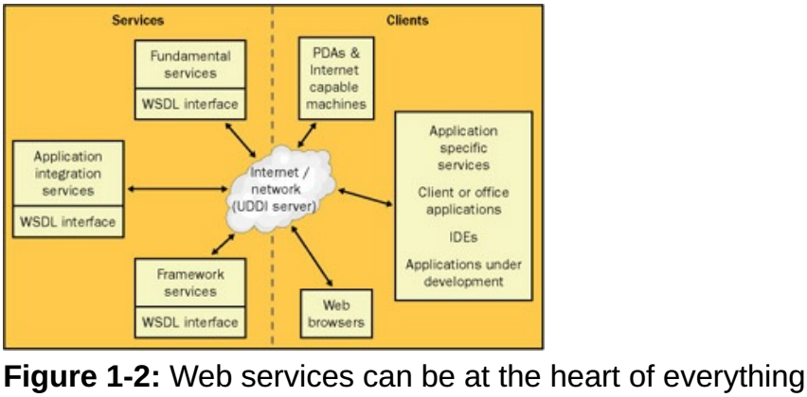
Figure 1-2

Slide 23
.NET
When Microsoft announced .NET as the replacement for COM and DCOM, one new feature it placed front and center was its intrinsic support for Web services.
Whereas the SOAP Toolkit gave COM developers the ability to create and consume Web services, the .NET Framework and Visual Studio .NET made it considerably easier to do both.
The creation and transmission of a request to a Web service was reduced to a single method call if you chose to leave it as such.
The .NET Web service classes are also open enough that you can alter almost any aspect of a call or XML if you want.
Web services are not just a part of the .NET Framework; they’re at the heart of Microsoft’s strategy for future application development.
Microsoft’s n-tier design for enterprise applications hasn’t changed the division between data, business logic, and presentation logic, but it has refined the categorization of that logic into seven service layers.
Figure 1- 3 shows the .NET model for a distributed enterprise application.
In this model, the Web services layer acts as an intermediary between the presentation and business rules tiers, receiving and returning input and data from clients and acting accordingly.

Slide 24
.NET |
Of course, this assumes that the presentation and business rules tiers are on different machines that are connectable over some type of network.
If they’re both on the same machine, the Business façade layer takes on this middleman role.
One of the first products Microsoft tried to bring out under the .NET banner was a set of consumer-oriented Web services that replaced and enhanced the Microsoft Passport and Wallet products.
However, .NET My Services, as it was known, was rejected by potential users, who were not convinced that Microsoft could provide and be trusted with a secure central data store on which the services would run.
Public trust aside, the protracted rollout of .NET-based servers and applications means that the Microsoft world will be a place where almost every document is in XML and every server can expose some of its functionality as a Web service that applications can make use of remotely.
As far as Microsoft is concerned, interoperability is the key to the future.

Slide 25
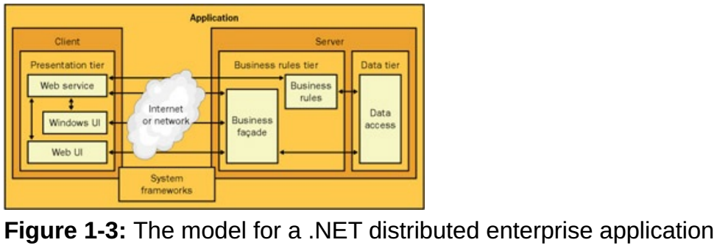
Figure 1-3

Slide 26
Web Service Scenarios
Everyone has an answer to the question “What is a Web service?” but at least you can now see where Web services fit into the grand scheme of things and can settle on a definition of your own.
Here, we define a Web service as a remotely accessible application component that listens for certain text-based requests, usually made over HTTP, and reacts to them.
Web services might not return results in the same way, and what the request is for is irrelevant.
Similarly, a service might be used internally by a single application or exposed externally over the Internet for use by any number of applications.
What matters is the agnostic nature of the request and its handling.
In practice, there are three general types of Web services:
simple services
application integration services
framework services
We’ll look at each in turn.

Slide 27
Simple Services
The most basic premise for Web services is to provide a simple piece of functionality to the client: data retrieval or simple calculations.
For example, an e-commerce site might allow a client to query the shipping cost for a given number of items or query for further details about an item.
The workings behind the service might be complex, but its purpose is quite straightforward.
We’ll look at a few very simple services later in this chapter.

Slide 28
Application Integration Services
As networks and Internet connections get faster, companies are taking advantage of the increased bandwidth by spreading out their applications and resources over networks and locales.
Several servers can talk to each other autonomously and to other applications as well.
This integration is fine within a company that uses the same kind of systems, but what if companies want to share their resources with other companies?
Common sense would say that their systems would not be instantly compatible.
One fundamental point about the Web service platform is that any machine can expose Web services to and consume Web services from various other platforms— something that cannot be said for any other technology that enables distributed applications.
Application integration, or middlemen, services work as intermediaries between applications that wouldn’t normally be able to talk with each other because they were written for different platforms, use different component architectures, and so on.
Their functionality or data can be exposed through a set of Web services.
Composite applications can then be created on one central system that knows the calls to make to the services to get the information they need from the various systems.

Slide 29
Framework Services
The idea of Web services as application add-ins probably shouldn’t surprise anyone.
The concept of a bolt-on component that provides additional functionality to an application isn’t new, but it fits the way Web services work to a tee.
Consider for a moment the general characteristics of Web services—loosely coupled, omnipresent thanks to permanent Internet connections—and you can see how they could be used in the same way as add- ins but on the hosting server rather than on the client.
These characteristics of Web services, along with their platform-agnosticism, means that a developer need only write one plug-in for the application regardless of the platform it runs on as long as the Web service interface fits in with the framework laid down by the application.
And because the code for the add-in is centralized on the server rather than on the client, deploying an update to the code is a matter of making it live on the server rather than giving it to all clients.
The Microsoft BizTalk Framework already supports this kind of “plug-in” solution.
The workflow solutions that a developer creates against BizTalk allow for the inclusion of Web service plug-ins to mirror the addition of new decisions and expansions to already established processes.
This concept also mirrors neatly the continuing development of XML grammars for various vertical markets—finance, bioinformatics, chemistry, and so on.

Slide 30
Framework Services |
Consider the use of service plug-ins in a situation where a finance package is given information formatted using a schema other than its default.
A service plug-in can be called on to transform the information from one markup language to another (using XSLT, for example).

Slide 31
Web Services vs .NET Remoting
This book is very pro–Web services, as it should be, but it’s worth reiterating that Web services are not a substitute for a full-fledged distributed application built using DCOM, RMI, or the .NET equivalent, .NET remoting.
There are very good reasons why one might use remoting or an equivalent model over Web services as the basis for a solution:
Performance: Web services work over open standards, which take a lot of work to adhere to.
For example, converting messages to and from XML on each side of the network takes a lot of work.
Likewise, using HTTP as the transport protocol is relatively slow, even on a LAN.
Security: Web services are not very secure yet.
Even though calls might be made over HTTPS and new ideas for secure communication appear quite frequently, there is no security standard and little help to fall back on if things go wrong.
Control: Not having to adhere to standards means you have greater control over your application and can play to the framework’s strengths.
In .NET, for example, you can use data types that don’t serialize faithfully into XSD types and back, customize the communications infrastructure, and optimize the application as you see fit.

Slide 32
Web Services vs .NET Remoting |
If the various endpoints of a distributed application are running on the same platform, there’s no need to worry about the agnostic advantages of Web services.
You can instead take advantage of the native RPC calls that remoting makes without having to worry about prior parsing and reparsing, and you can make some useful performance improvements.
Likewise, you can lock down a remoted application with Windows-based and code-based security measures more tightly than you can a Web services–based application.

Slide 33
Developing a Web Service
Now to the nitty-gritty of Web services: how do you create one and then get an application to make use of it?
What tools do you use? Truth be told, although we work with trivial code for demo purposes, a basic text editor such as Notepad can do the job.
Likewise, you can use any tool you’d usually use for .NET development to work with services— Emacs, Dreamweaver MX, CodeWarrior.
However, we’ll use Visual Studio .NET throughout the book for examples of larger projects that favor the creation and consumption of Web services.
As you’d expect, Visual Studio .NET helps a great deal in the creation of boilerplate code and easy-to- manage projects, and it provides a lot of help in packaging up code for deployment elsewhere.
We’ll look at the Web service– specific features of Visual Studio .NET as we go.

Slide 34
A Simple Example in Notepad

Slide 35
The Life Cycle of a Web Service Request

Slide 36
Message Formats

Slide 37
A Simple Example in Web Matrix

Slide 38
A Simple Example in Visual Studio .NET

Slide 39
Project Files

Slide 40
How Does It Work?

Slide 41
Declaring a Web Service

Slide 42
The WebService Attribute

Slide 43
The WebMethod Attribute

Slide 44
Code-Behind Files

Slide 45
Developing a Web Service Client

Slide 46
Building on the Foundation

Slide 47
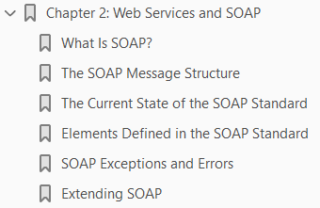
2

Slide 48
Intro

Slide 49
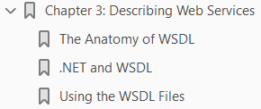
3

Slide 50
Intro

Slide 51
4

Slide 52
Intro

Slide 53
5

Slide 54
Intro

Slide 55
6

Slide 56
Intro

Slide 57
7

Slide 58
Intro

Slide 59
8

Slide 60
Intro

Slide 61
9

Slide 62
Intro

Slide 63
10

Slide 64
Intro

Slide 65
Appendix

